Slide 1
SQL Server on Azure VM Configuring For Price-Performance
<speaker name>
Notes:
When selecting a virtual machine to host your SQL Server workload in Azure, you need to choose a virtual machine size that provides optimal performance and fits your organization’s budget. There are a number of different compute and storage options in Azure, so choosing the configuration that gives you the best price-performance for your workload can be a challenge. In this session, we will cover topics such as the different virtual machine types that are most appropriate for SQL Server workloads (including the new Ebdsv5 series), configuring storage, and features unique to Azure such as host caching and write acceleration that can help boost your performance without breaking the bank.

Slide 2

Notes:
When customers consider moving to the cloud.. What do they do typically do? From our experience, many times we are sizing SQL Server workloads by memory and CPU. It makes sense to size by cores as we are sizing based on what we have licensed, maybe we are looking at Azure Hybrid Benefits and are taking the best advantage of this benefit, and of course we know SQL Server benefits from memory as SQL Server takes advantage of what’s cached in the buffer pool and many components on the SQLOS takes advantage of memory.
- but we often miss the opportunity to size based on throughput and IOPs and this is commonly where customers are needing the performance.
The reason for this is not fully understanding the difference of CAPEX and OPEX and how it should change the way we approach architecting solutions in the cloud and how we should test and interpret the results of those tests.
To put it simply, in the cloud we only want to use what we need.
In order to accomplish this, we need to have a strong user experience - we have to carefully size and we must always be tuning (ABT) our workloads.

Slide 3
Understanding Azure VM Options
Notes:
Switch to Pam

Slide 4


Azure Compute Options
Virtual Machines
DCsv2
Dadsv5
Av2
B
Ddsv5
Fsv2
Entry level
Burstable
General Purpose and Confidential Computing
Compute intensive
Preferred for most SQL Server workloads
Used for basic SQL Server workloads
Edsv5
Ebdsv5
NC
NCv2
ND
Eadsv5
NDv2
H
HB
Mv2
Msv2
NCv3
NDv2
NVv3
NVv4
NCasT4 _v3
HBv3
HC
Lsv3
M
Mdsv2
Memory optimized
GPU accelerated
High Performance Computing
Storage optimized
https://aka.ms/SQLIaaSPerf
Notes:
Azure compute options
Azure offers Virtual Machine types and sizes that can address almost every type of workload - dev/test workloads, burstable, mission-critical production workloads, small scale to large systems that would support SQL Server and SAP.
We offer VM series optimized for compute, memory, disk, GPU intensive, and more - The portfolio is growing constantly.
But, for our purposes, we are focused on SQL Server and data warehousing workloads that offer 4, 8, 16, 32 and higher core counts. A strong memory to core ratio, and solid throughput with the right mix of performance features.
For this reason, we optimize for the two main VM types for enterprise workloads:
Memory optimized - Memory optimized VM sizes offers large amounts of memory and CPU, high memory-to-core ratios that’s strong for relational database servers, premium disk and cache support, and write acceleration capabilities.
Updates: Msv2 and Mdsv2-series Medium Memory (Preview) - only runs the Intel Xeon Platinum 8280 (Cascade Lake) processors. These machines are Gen 2 only and are designed to give M-series features at with a mid-tiered memory profile. With these VMs, customers achieve increased flexibility with both local disk and diskless options.
These new isolated VM sizes with more CPU and memory go up to 192 vCPU with 4 TiB of memory.
General Purpose and Confidential Computing - For departmental workloads, and by this, I mean lower user counts, maybe smaller purposed shrink-wrap applications that need a local database support, we recommend some of the machines in the General Purpose and Confidential Computing type:
General purpose VM sizes provide balanced, but lower mem-to-core ratio. This might be good for smaller departmental database servers.
In particular we recommend the Ddsv4-series, Dasv4-series, and the Dsv4-series because of the premium disk support.
Storage optimized - An honorable mention for specialized workloads is the storage optimized VM sizes. These machines have high disk throughput and IO and can be strong for Big Data, ETL, Operational Data Store (ODS), and data warehousing processing where you can certainly recreate from sourced data in an Azure Data Lake, etc.
The key feature of the Lsv2-series is very high throughput & low latency storage with directly mapped local NVMe which is ephemeral in nature.
The ephemeral nature of the disks are the biggest point to architect around as well as the fact that this series does not have Premium Storage Caching.
For these machines there is a consistent 8 GiB of memory per core, and one 1.92 TB NVMe SSD device per 8 vCPUs.
Scenarios that maintain data on local NVMe disks include:
The VM is running and healthy.
The VM is rebooted in place (by you or Azure).
The VM is paused (stopped without de-allocation).
The majority of the planned maintenance servicing operations.
Scenarios that securely erase data to protect the customer include:
The VM is redeployed, stopped (de-allocated), or deleted (by you).
The VM becomes unhealthy and has to service heal to another node due to a hardware issue.
A small number of the planned maintenance servicing operations that requires the VM to be reallocated to another host for servicing.
**Other Updates**
Standard_E80ids_v4 - We also have the relatively new addition to the EDsv4-series with the Standard_E80ids_v4 that has 80 CPU and 504 GiB of memory.
NCas_T4_v3-Series - There is also a new GPU-accelerated option with the NCas_T4_v3-Series VMs which is now generally available.
Memory optimized virtual machine sizes
M and Mv2 series
The M-series offers vCore counts and memory for some of the largest SQL Server workloads.
The Mv2-series has the highest vCore counts and memory and is recommended for mission critical and data warehouse workloads. Mv2-series instances are memory optimized VM sizes providing unparalleled computational performance to support large in-memory databases and workloads with a high memory-to-CPU ratio that is perfect for relational database servers, large caches, and in-memory analytics.
The Standard_M64ms has a 1:28 vCore-to-memory ratio for example.
Some of the features of the M and Mv2-series attractive for SQL Server performance include premium storage and premium storage caching support, ultra-disk support, and write acceleration.
Edsv4-series
The Edsv4-series is designed for memory-intensive applications. These VMs have a large local storage SSD capacity, strong local disk IOPS, up to 504 GiB of RAM, and improved compute compared to the previous Ev3/Esv3 sizes with Gen2 VMs. There is a nearly consistent vCore-to-memory ratio of 1:8 across these virtual machines, which is ideal for standard SQL Server workloads.
This VM series is ideal for memory-intensive enterprise applications and applications that benefit from low latency, high-speed local storage.
The Edsv4-series virtual machines support premium storage, and premium storage caching.
DSv2-series 11-15
The DSv2-series 11-15 has the same memory and disk configurations as the previous D-series. This series has a consistent memory-to-CPU ratio of 7 across all virtual machines.
The DSv2-series 11-15 supports premium storage and premium storage caching, which is strongly recommended for optimal performance.
General Purpose optimized virtual machine sizes
Ddsv4 series
The Ddsv4-series offers a fair combination of vCPU, memory, and temporary disk but with smaller vCore-to-memory support.
The Ddsv4 VMs include lower latency and higher-speed local storage.
These machines are ideal for side-by-side SQL and app deployments that require fast access to temp storage and departmental relational databases. There is a standard vCore-to-memory ratio of 4 across all of the virtual machines in this series.
For this reason, it is recommended to leverage the D8ds_v4 as the starter virtual machine in this series, which has 8 vCores and 32 GBs of memory. The largest machine is the D64ds_v4, which has 64 vCores and 256 GBs of memory.
Note: The Ddsv4-series does not have the recommended vCore-to-memory ratio of 1:8 that is recommended for SQL Server workloads. For this reason, it is recommended to leverage these virtual machines for smaller application and development workloads only.
The Ddsv4-series virtual machines support premium storage and premium storage caching.
Storage optimized
Lsv2-series
The Lsv2-series features high throughput, low latency, and local NVMe storage. The Lsv2-series VMs are optimized to use the local disk on the node attached directly to the VM rather than using durable data disks.
These virtual machines are strong options for big data, data warehouse, reporting, and ETL workloads. The high throughput and IOPs of the local NVMe storage is a good use case for processing files that will be loaded into your database and other scenarios where the source data can be recreated from the source system or other repositories such as Azure Blob storage or Azure Data Lake. Lsv2-series VMs can also burst their disk performance for up to 30 minutes at a time.
These virtual machines size from 8 to 80 vCPU with 8 GiB of memory per vCPU and for every 8 vCPUs there is 1.92 TB of NVMe SSD. This means for the largest VM of this series, the L80s_v2, there is 80 vCPU and 640 BiB of memory with 10x1.92TB of NVMe storage. There is a consistent vCore-to-memory ratio of 1:8 across all of these virtual machines.
The NVMe storage is ephemeral meaning that data will be lost on these disks if you restart your virtual machine.
The Lsv2 and Ls series support premium storage, but not premium storage caching. The creation of a local cache to increase IOPs is not supported.
Warning: Storing your data files on the ephemeral NVMe storage could result in data loss when the VM is deallocated.
Good reference: https://azure.microsoft.com/en-us/updates/?product=virtual-machines

Slide 5
Naming convention explanation
Family and Sub-family - Indicates the VM Family Series and specialized variations
# of vCPUs - Denotes the number of vCPUs of the VM
Features:
Accelerator Type - Denotes the type of hardware accelerator in the specialized/GPU SKUs.
Version - Denotes the version of the VM Family Series
a = AMD-based processor
b = bandwidth (highest I/O throughput available in Azure VMs)
d = diskfull (local temp disk is present); this is for newer Azure VMs, see Ddv4 and Ddsv4-series
i = isolated size
l = low memory; a lower amount of memory than the memory intensive size
m = memory intensive; the most amount of memory in a particular size
t = tiny memory; the smallest amount of memory in a particular size
s = Premium Storage capable, including possible use of Ultra SSD (Note: some newer sizes without the attribute of s can still support Premium Storage e.g. M128, M64, etc.)
https://docs.microsoft.com/azure/virtual-machines/vm-naming-conventions
Notes:
Standard_E64ds_v4
Naming convention explanation
[Family] + [Sub-family]* + [# of vCPUs] + [Additive Features] + [Accelerator Type]* + [Version]
NAMING CONVENTION EXPLANATION
Family - Indicates the VM Family Series
*Sub-family - Used for specialized VM differentiations only
# of vCPUs - Denotes the number of vCPUs of the VM
Additive Features - One or more lower case letters denote additive features, such as: a = AMD-based processor d = disk (local temp disk is present); this is for newer Azure VMs, see Ddv4 and Ddsv4-series m = memory intensive; the most amount of memory in a particular size s = Premium Storage capable, including possible use of Ultra SSD (Note: some newer sizes without the attribute of s can still support Premium Storage e.g. M128, M64, etc.) i = isolated size h = hibernation capable l = low memory; a lower amount of memory than the memory intensive size t = tiny memory; the smallest amount of memory in a particular size r = RDMA capable
Accelerator Type - Denotes the type of hardware accelerator in the specialized/GPU SKUs. Only the new specialized/GPU SKUs launched from Q3 2020 will have the hardware accelerator in the name.
Version - Denotes the version of the VM Family Series

Slide 6
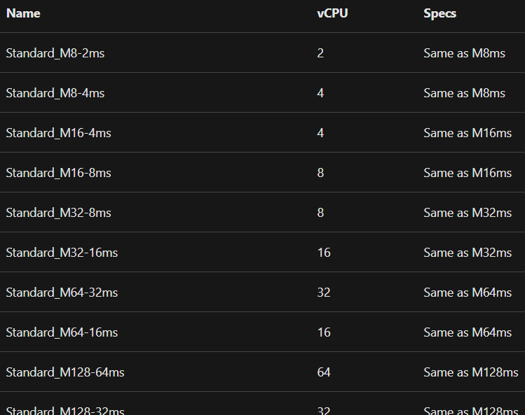
Optimize SQL Server license cost with constrained vCPU VMs
Azure offers VM sizes where you can constrain the vCPU count to reduce the cost of software licensing, while maintaining the same memory, storage, and I/O bandwidth
https://docs.microsoft.com/en-us/azure/virtual-machines/windows/constrained-vcpu
Notes:
*Only available for the memory optimized virtual machine sizes
Constrained vCPU capable VM sizes
Some database workloads like SQL Server or Oracle require high memory, storage, and I/O bandwidth, but not a high core count. Many database workloads are not CPU-intensive. Azure offers certain VM sizes where you can constrain the VM vCPU count to reduce the cost of software licensing, while maintaining the same memory, storage, and I/O bandwidth.
The vCPU count can be constrained to one half or one quarter of the original VM size. These new VM sizes have a suffix that specifies the number of active vCPUs to make them easier for you to identify.
For example, the current VM size Standard_GS5 comes with 32 vCPUs, 448 GB RAM, 64 disks (up to 256 TB), and 80,000 IOPs or 2 GB/s of I/O bandwidth. The new VM sizes Standard_GS5-16 and Standard_GS5-8 comes with 16 and 8 active vCPUs respectively, while maintaining the rest of the specs of the Standard_GS5 for memory, storage, and I/O bandwidth.
The licensing fees charged for SQL Server or Oracle are constrained to the new vCPU count, and other products should be charged based on the new vCPU count. This results in a 50% to 75% increase in the ratio of the VM specs to active (billable) vCPUs. These new VM sizes allow customer workloads to use the same memory, storage, and I/O bandwidth while optimizing their software licensing cost. At this time, the compute cost, which includes OS licensing, remains the same one as the original size.
Reference:
https://docs.microsoft.com/en-us/azure/virtual-machines/constrained-vcpu

Slide 7




Azure Virtual Machine Disk Provisioning
D:/
Uncached Managed Disk
Cached Managed Disk
Local / Temp
Disk
Disk-Level Provisioning
Disk-Level Provisioning
SSD-Level Provisioning
Cache Miss
Cache Hit
VM Network-Level Provisioning
Server SSD
Azure Storage Page BLOBs
Notes:
Disk allocation and performance
Here we are showing the distribution of bandwidth and IOPS for disks, using a three-level provisioning system:
1. The first level provisioning sets the per-disk IOPS and bandwidth from the VM.
2. At the second level, compute server host implements SSD provisioning, applying it only to data that is stored on the server’s local SSD, which includes disks with caching (ReadWrite and ReadOnly) as well as local and temp disks.
3. Finally, VM network provisioning takes place at the third level for any I/O that the compute host sends to Azure Storage's backend. Here, the performance of a VM depends on a several factors from how the VM uses the local SSD, to the number of disks attached, as well as the performance and caching type of the disks attached.
https://docs.microsoft.com/azure/virtual-machines/managed-disks-overview

Slide 8
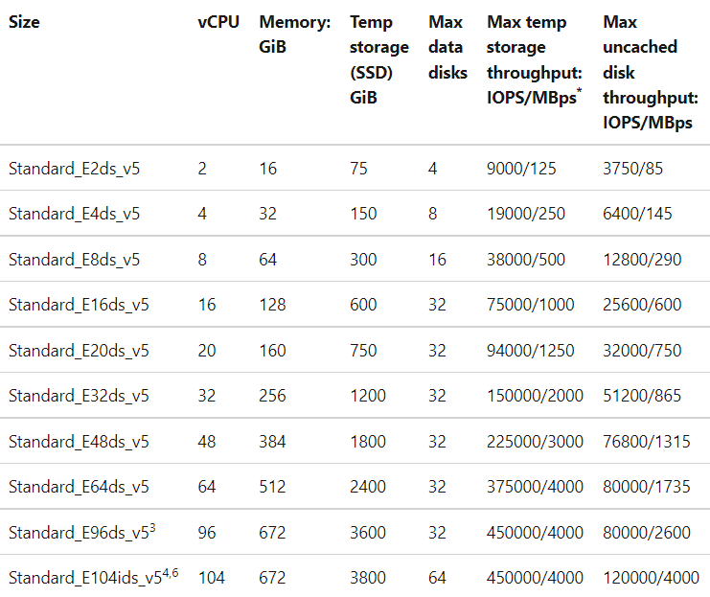
VM I/O Limits
https://learn.microsoft.com/azure/virtual-machines/edv5-edsv5-series
Notes:
** These IOPs values can be guaranteed by using Gen2 VMs

Slide 9
VM I/O Limits
VM network-level provisioning
Notes:
Max uncached disk throughput is the VM-level limit for remote storage.

Slide 10
VM I/O Limits
Size of D: drive
SSD-level provisioning
Notes:
Max cached and temp storage throughput is the VM limit for local SSD storage. This includes I/O against the local ephemeral drive (D: drive) and the cache.

Slide 11
Azure Virtual Machine Disk Provisioning
D:/
Uncached P30 Managed Disk
Cached P30 Managed Disk
Local / Temp
Disk
5,000 IOPS 200 MBps
5,000 IOPS 200 MBps
38,000 IOPS, 500 MBps
Cache Miss
Cache Hit
12,800 IOPS, 290 MBps
Server SSD
Azure Storage Page BLOBs
Notes:
Disk allocation and performance
Let’s see how this applies to the virtual machine we have been using in our examples.
Consider the Standard_E8ds_v4. The Standard_E8ds_v4 would prevent achieving the 20,000 IOPS of a 4 x P30 storage pool, because of limits at the VM level.
Now, if the pool could leverage read-only caching, we could improve on this limitation with an additional 64,000 IOPS.
We are able to leverage the ephemeral disk for tempdb which won’t count against our uncached IOPS and throughput.
Spreading out and isolating these data, log and tempdb further ensures workloads can get the expected IOPS and throughput it needs.
You can use the VM-level and Disk-level metrics to track the performance and setup alerts as needed. Please see the references on Azure Disk Metrics and our previous performance monitor references.
-------------------------------------
Other Points:
Some things to be aware of is that Azure prioritizes the network channel for disk traffic over other lower priority traffic which helps improve performance and Azure Storage implements automatic load balancing.
Azure Storage allocates required resources when you create a disk and applies proactive and reactive balancing of resources to handle the traffic level.

Slide 12
Azure Virtual Machine Disk Provisioning
D:/
Uncached P30 Managed Disk
Cached P30 Managed Disk
Local / Temp
Disk
5,000 IOPS 200 MBps
5,000 IOPS 200 MBps
Transaction Log files
(host caching = None)
38,000 IOPS, 500 MBps
Cache Miss
Cache Hit
12,800 IOPS, 290 MBps
Server SSD
Azure Storage Page BLOBs
Notes:
Disk allocation and performance
Let’s see how this applies to the virtual machine we have been using in our examples.
Consider the Standard_E8ds_v4. The Standard_E8ds_v4 would prevent achieving the 20,000 IOPS of a 4 x P30 storage pool, because of limits at the VM level.
Now, if the pool could leverage read-only caching, we could improve on this limitation with an additional 64,000 IOPS.
We are able to leverage the ephemeral disk for tempdb which won’t count against our uncached IOPS and throughput.
Spreading out and isolating these data, log and tempdb further ensures workloads can get the expected IOPS and throughput it needs.
You can use the VM-level and Disk-level metrics to track the performance and setup alerts as needed. Please see the references on Azure Disk Metrics and our previous performance monitor references.
-------------------------------------
Other Points:
Some things to be aware of is that Azure prioritizes the network channel for disk traffic over other lower priority traffic which helps improve performance and Azure Storage implements automatic load balancing.
Azure Storage allocates required resources when you create a disk and applies proactive and reactive balancing of resources to handle the traffic level.

Slide 13
Azure Virtual Machine Disk Provisioning
D:/
Uncached P30 Managed Disk
Cached P30 Managed Disk
Local / Temp
Disk
5,000 IOPS 200 MBps
5,000 IOPS 200 MBps
Data files
(host caching = Read-only)
38,000 IOPS, 500 MBps
Cache Miss
Cache Hit
12,800 IOPS, 290 MBps
Server SSD
Azure Storage Page BLOBs
Notes:
Disk allocation and performance
Let’s see how this applies to the virtual machine we have been using in our examples.
Consider the Standard_E8ds_v4. The Standard_E8ds_v4 would prevent achieving the 20,000 IOPS of a 4 x P30 storage pool, because of limits at the VM level.
Now, if the pool could leverage read-only caching, we could improve on this limitation with an additional 64,000 IOPS.
We are able to leverage the ephemeral disk for tempdb which won’t count against our uncached IOPS and throughput.
Spreading out and isolating these data, log and tempdb further ensures workloads can get the expected IOPS and throughput it needs.
You can use the VM-level and Disk-level metrics to track the performance and setup alerts as needed. Please see the references on Azure Disk Metrics and our previous performance monitor references.
-------------------------------------
Other Points:
Some things to be aware of is that Azure prioritizes the network channel for disk traffic over other lower priority traffic which helps improve performance and Azure Storage implements automatic load balancing.
Azure Storage allocates required resources when you create a disk and applies proactive and reactive balancing of resources to handle the traffic level.

Slide 14
Azure Virtual Machine Disk Provisioning
D:/
Uncached P30 Managed Disk
Cached P30 Managed Disk
Local / Temp
Disk
5,000 IOPS 200 MBps
5,000 IOPS 200 MBps
38,000 IOPS, 500 MBps
tempdb files
(local drive, no caching)
Cache Miss
Cache Hit
12,800 IOPS, 290 MBps
Server SSD
Azure Storage Page BLOBs
Notes:
Disk allocation and performance
Let’s see how this applies to the virtual machine we have been using in our examples.
Consider the Standard_E8ds_v4. The Standard_E8ds_v4 would prevent achieving the 20,000 IOPS of a 4 x P30 storage pool, because of limits at the VM level.
Now, if the pool could leverage read-only caching, we could improve on this limitation with an additional 64,000 IOPS.
We are able to leverage the ephemeral disk for tempdb which won’t count against our uncached IOPS and throughput.
Spreading out and isolating these data, log and tempdb further ensures workloads can get the expected IOPS and throughput it needs.
You can use the VM-level and Disk-level metrics to track the performance and setup alerts as needed. Please see the references on Azure Disk Metrics and our previous performance monitor references.
-------------------------------------
Other Points:
Some things to be aware of is that Azure prioritizes the network channel for disk traffic over other lower priority traffic which helps improve performance and Azure Storage implements automatic load balancing.
Azure Storage allocates required resources when you create a disk and applies proactive and reactive balancing of resources to handle the traffic level.

Slide 15
Choosing the Right VM Size
Notes:
Switch to Pam

Slide 16

Measure Application Performance Requirements
Counter | Description | PerfMon (Windows) | Iostat (Linux)
IOPS or Transactions per second | Number of I/O requests issued to the storage disk per second. | Disk Reads/sec | tps
 |  | Disk Writes/sec | r/s
 |  |  | w/s
Throughput | Amount of data read from or written to the disk per second. | Disk Read Bytes/sec | kB_read/s
 |  | Disk Write Bytes/sec | kB_wrtn/s
Latency | Total time to complete a disk IO request. | Average Disk sec/Read | await
 |  | Average disk sec/Write | svctm
Uncached IOPS/MBps
Roughly maps to transaction log reads and writes + data file writes and ~ 70% of reads (depends on host cache hit ratio)
Cached and local IOPS/MBps
Roughly maps to tempdb reads and writes + data file reads and writes
Notes:
Counters to measure application performance requirements
The best way to measure performance requirements of your application, is to use performance-monitoring tools provided by the operating system of the server. You can use PerfMon for Windows and iostat for Linux. These tools capture counters corresponding to each measure explained in the above section. You must capture the values of these counters when your application is running its normal, peak, and off-hours workloads.
The PerfMon counters are available for processor, memory and, each logical disk and physical disk of your server. When you use premium storage disks with a VM, the physical disk counters are for each premium storage disk, and logical disk counters are for each volume created on the premium storage disks. You must capture the values for the disks that host your application workload. If there is a one to one mapping between logical and physical disks, you can refer to physical disk counters; otherwise refer to the logical disk counters.
On Linux, the iostat command generates a CPU and disk utilization report. The disk utilization report provides statistics per physical device or partition. If you have a database server with its data and logs on separate disks, collect this data for both disks.
Counters to measure application performance requirements
https://docs.microsoft.com/en-us/azure/virtual-machines/premium-storage-performance#counters-to-measure-application-performance-requirements

Slide 17
New Ebdsv5 VM Series (#DoubleSprinklesVM)
Higher I/O throughput at lower core counts, purposefully designed with RDBMS in mind
Generally available today!
Improves price-perf by 34% compared to Edsv4
Size | vCPU | Memory: GiB | Max uncached disk throughput: IOPS/MBps
Standard_E2bds_v5 | 2 | 16 | 5500/156
Standard_E4bds_v5 | 4 | 32 | 11000/350
Standard_E8bds_v5 | 8 | 64 | 22000/625
Standard_E16bds_v5 | 16 | 128 | 44000/1250
Standard_E32bds_v5 | 32 | 256 | 88000/2500
Standard_E48bds_v5 | 48 | 384 | 120000/4000
Standard_E64bds_v5 | 64 | 512 | 120000/4000
TPC-C | E64-32ds_v4 | E32bds_v5
Storage Config | Data pool, 12 P30s Log pool, 4 P30s | Data pool, 18 P30s Log pool, 2 P30s
Compute Cost* | $3,784.32/month | $1,950.56/month
Storage Cost | $2,162.72/month | $2,703.40/month
Total Cost | $5,947.04/month | $4,653.96/month
NOPM | 1,065,949 | 1,259,418
Price/Perf Ratio* | $5.57/1000 NOPM | $3.70/1000 NOPM
* This cost is for pay-as-you-go compute only, assuming Azure Hybrid Benefit for both Windows OS and SQL Server licensing costs.
Now in Public Preview!
Size | vCPU | Memory: GiB | Max uncached disk throughput: IOPS/MBps
Standard_E96bds_v5 | 96 | 672 | 260000/7500
Standard_E112ibds_v5 | 4 | 32 | 260000/8000
https://aka.ms/Ebsv5NVMePublicPreview

Slide 18

Recommended SQL VM Series
Ebdsv5-series
M-series
Highest I/O throughput and memory available in Azure
Great for mission critical OLTP and high-end data warehouse workloads
Best all-purpose SQL Server virtual machine
Large local drives with high local/cached throughput
Ddsv5-series
Entry level SQL Server virtual machine
Offers best price-performance for SQL Server workloads
Good remote throughput
Expensive – it is recommended to start with Ebdsv5 first if possible
Works for smaller production database environments
Good choice for dev/test workloads
Notes:
Ebdsv5-series
Ideal for memory-intensive enterprise applications
Large local storage SSD capacity and throughput
Ideal core to memory ratio of 1:8 across all sizes
Highest I/O throughput of any VM series in Azure
M-series*
vCore counts and memory for the largest workloads
Core to memory ratios of 1:30 w/o constrained cores; 1:121 with constrained cores
Mission Critical and Data Warehouse VM options
Ddsv5
Supports Premium Storage
Supports Premium Storage Caching
Good entry level SQL Server virtual machine

Slide 19
Recommended SQL VM Memory Optimized Series
Ebdsv5-series
M-series
Highest I/O throughput and memory available in Azure
Great for mission critical OLTP and high-end data warehouse workloads
Highest remote I/O throughput available in Azure
DSv2-series 11-15
Good entry level SQL Server virtual machine
Very expensive – start with Edsv4 first if possible
Large local drives with high local/cached throughput
Offers the best price-performance for SQL Server workloads
When in doubt, pick this one! #DoubleSprinklesVMs
Notes:
Going quick here..
We recommend the Memory Optimized virtual machines, the Storage Optimized, and some select General Purpose virtual machines.- check episode 1 for more information.
We primarily recommend memory optimized virtual machine sizes as the primary target for SQL Server VMs and it’s the recommended choice for SQL Server.
The DSv2-series 11-15 has a consistent memory-to-CPU ratio of 7 across all virtual machines and premium storage and premium storage caching, which is strongly recommended for optimal performance.
The Edsv4-series, has strong storage throughput, large local storage SSD capacity, strong local disk IOPS, up to 504 GiB of RAM, improved compute compared to the previous versions and there is consistent vCore-to-memory ratio of 1:8 across these virtual machines as you scale – and of course these machines also support premium storage, and premium storage caching.
The M-series, including M, Mv2, Msv2, and Mdsv2 Medium, has higher vCore counts and memory for some of the largest SQL Server workloads. Think it terms of big workloads, larger memory to core ratio, and mission critical or data warehouse needs. The Mv2-series has the highest vCore counts and memory and is recommended for mission critical and data warehouse workloads.
This M-series supports premium storage and premium storage caching support, has ultra-disk support, and write acceleration.
There is also the new Msv2 and Mdsv2-series Medium Memory which as a mid-tiered memory profile in comparison with the other M-series options.

Slide 20
Choosing the right storage

Slide 21
Azure Managed Disk Options
NEW!!!
 | Ultra Disk | Premium SSD v2 | Premium SSD
Latency | Low sub millisecond average (< 0.5 ms) ~1 ms P99 | Sub millisecond average (< 1 ms) Less than 2 ms P99 | ~1 millisecond average Less than 5 ms P99
Disk size | 4 GiB - 64 TiB | 1 GiB - 64 TiB | 4 GiB - 32 TiB
Baseline IOPS | Varies by disk size | 3,000 IOPS free | Varies by disk size
Baseline throughput | Varies by disk size | 125 MBPS free | Varies by disk size
Max IOPS | 160,000 IOPS | 80,000 IOPS | 20,000 IOPS
Max throughput | 4,000 MBPS | 1,200 MBPS | 900 MBPS
http://aka.ms/azuredisks
Notes:
What disk types are available in Azure?
There are currently four basic disk options.
Standard HDD - Backup, non-critical, infrequent access; Standard SSDs have the S# naming convention
Standard SSD - Web servers, lightly used departmental apps and dev/test; Standard SSDs have the E# naming convention
Premium SSD - Production and performance sensitive workloads ; Premium disks have the P# naming convention
Ultra disk SSD - IO-intensive workloads such as SAP HANA, top tier databases (for example, SQL, Oracle), and other transaction-heavy workloads. These are independently configurable.
The new Premium SSD v2 was just introduced in limited regions (East US & West Europe)
Like standard HDDs, standard SSDs are available on all Azure VMs, but..
Recommendations
We do not recommend using Standard HDDs and Standard SSDs for SQL Server workloads – which is why I am going to turn off half the screen.
Standard disk options should only be used for non-production scenarios and maybe for web servers and lightweight application servers.
Not only is the IOPs and throughput lower than Premium and Ultra Disks, but it is also not guaranteed.
For Standard Disks, the actual IOPS and throughput may vary depending on the traffic patterns.
The IOPS and throughput limits are available 99% of the time.
Therefore, we only recommend Premium SSD and Ultra Disk options for production workloads.
Azure disk reservation
Just a real quick comment on pricing, disk reservation is another reason to consider premium disks. Disk reservations lets you prepurchase 1 year of disk storage in advance at a discount. When purchasing a disk reservation, you select a specific disk SKU in a target region for a one-year term. The reservation experience is similar to reserving virtual machine (VM) instances. You can even bundle VM and Disk reservations – so it can be a pretty effective way to maximize TCO.
For more details on the Reserved Disks pricing, see Azure Disks pricing page - http://aka.ms/azuredisks
Reference
About disks and VHDs for Azure virtual machines https://azure.microsoft.com/en-us/documentation/articles/virtual-machines-windows-about-disks-vhds/
Premium Storage: High-Performance Storage for Azure Virtual Machine Workloads
https://azure.microsoft.com/en-us/documentation/articles/storage-premium-storage/#ds-dsv2-and-gs-series-vms
Azure premium storage: design for high performance
https://docs.microsoft.com/en-us/azure/virtual-machines/premium-storage-performance

Slide 22
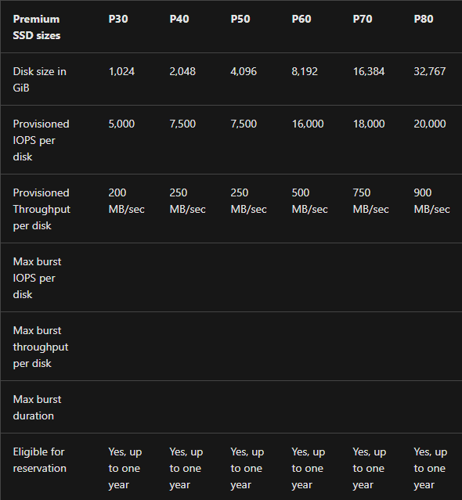
Premium SSD
Production and performance sensitive workloads
Disk-level provisioning
Notes:
Premium SSD
Premium SSDs have low-latency disk support perfect for IO-intensive mission-critical workloads. Premium SSDs can only be used with VM series that support premium storage and we only recommend VMs that support both Premium Disk storage and caching.
An Azure VM supports attaching several Premium Storage disks in a storage pool, so applications can have up to 64 TB of storage per VM. This is what Storage Spaces is doing for us behind the scenes – which we will get to in a little more detail, but just think of it as a software RAID solution for the purposes of combining disks for performance and capacity.
Virtual Machines can achieve up to 80,000 uncached IOPS (input/output operations per second) per VM and 2 GB uncached per second disk throughput using storage spaces.
Premium disks helps support this solution with disks scaled from the P1 up to the P80, but there are features only available on certain disk sizes. Bursting is available on the P1 to P20, caching is available on the P30 and P40s. Reservations are available for disks P30 and larger for example.
Recommendation:
Because of the caching support we only recommend using P30 and P40 for the Data disks. Caching support is not recommended for log files so admins can use P30 – P80 for the Log disks.
We recommend customers start with the P30 and use storage spaces to increase the throughput to the VMs limits.
It is not recommended to use disks that support disk level bursting (P1 – P20) as the experience can be inconsistent and lead to perceptions of poor performance.
The reason is that bursting is automatic and operates based on a credit system and under this credit system.
All burst disk sizes start with a full burst when the disk is attached to a Virtual Machine. Bursting supports a max duration at the peak burst limit of 30 mins.
I personally only recommend intentionally using bursting for web servers and application servers.
------------------------
Advice
Taking a look at the premium disk options, start considering disks at the P30 and P40 levels.
Most customers choose P30 or P40s for their SQL Server data files in a large stripe, storage pool and will have a separate pool for their log drive.
Separate data and log is very important, not just for workload separation, but for caching reasons which we will discuss later.
Remember, the disk IOps and throughput should not exceed what that virtual machine can handle.
What disk types are available in Azure? https://docs.microsoft.com/en-us/azure/virtual-machines/disks-types#premium-ssd

Slide 23
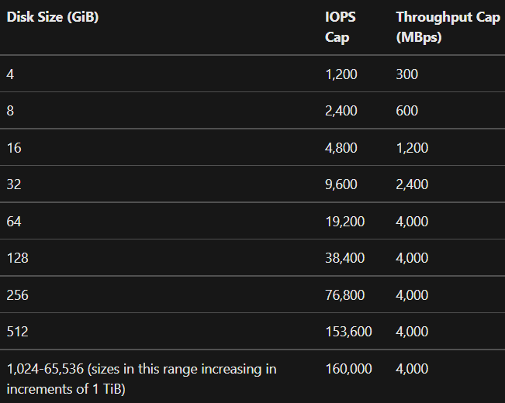
Ultra Disk
IO-intensive workloads such as top databases and other transaction-heavy workloads
Notes:
Ultra-disk
Ultra-disks have high throughput, high IOPS, and very low latency. Basically, you are paying for the latency. They are perfect for data-intensive workloads such high-end databases and transaction-heavy workloads. In particular, they are useful for the transaction log when you have high log usage from SQL Server features (such as replication + Always On AGs) and / or you have high WRITELOG waits.
Basically, use Ultra Disks for when you need very low latency writes (<1ms) to the log files
Ultra Disk is configurable - when you provision an ultra-disk, you can independently configure the capacity and performance of the disk separately - in several fixed sizes, ranging from 4 GiB up to 64 TiB.
Key Points:
Ultra-disks can dynamically adjust disk performance without the need to restart your virtual machines (VM).
There is no caching support – Ultra disks only supports un-cached reads and un-cached writes.
Ultra-disk performance:
Disk capacity: Ultra disks capacity ranges from 4 GiB up to 64 TiB.
Disk IOPS: Ultra disks support IOPS limits of 300 IOPS/GiB, up to a maximum of 160K IOPS per disk.
To achieve the IOPS that you provisioned, ensure that the selected Disk IOPS are less than the VM IOPS limit (avoid VM throttling / capping).
Disk throughput: With ultra-disks, the throughput limit is up to a maximum of 2 GBs (2000 MBps) per disk.
Ultra-disks supports adjusting the disk performance attributes (IOPS and throughput) at runtime without detaching the disk from the virtual machine.
Ultra-disks limitations:
The only infrastructure redundancy options currently supported are availability zones.
Not every VM size is available in every supported region with ultra-disks.
Does not support disk caching
Doesn't currently support disk snapshots, VM images, availability sets, Azure Dedicated Hosts, or Azure disk encryption.
Doesn't currently support integration with Azure Backup or Azure Site Recovery.
------------------------------------------
Once a disk performance resize operation has been issued on a disk, it can take up to an hour for the change to actually take effect.
There is a limit of four performance resize operations during a 24-hour window.
It is possible for a performance resize operation to fail due to a lack of performance bandwidth capacity.
References: What disk types are available in Azure? https://docs.microsoft.com/en-us/azure/virtual-machines/disks-types#ultra-disk
Using Azure ultra disks
https://docs.microsoft.com/en-us/azure/virtual-machines/disks-enable-ultra-ssd?tabs=azure-portal

Slide 24
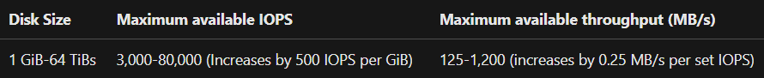
Premium SSD v2
Lower latency than v1 and fully configurable/scalable IOPS and throughput. Best choice for price-perf.
Example:
GiB | Max IOPS | Max MBPS
1 GiB | 3000 | 750
6 GiB | 3000 | 750
7 GiB | 3500 | 875
10 GiB | 5000 | 1200
160 GiB | 80,000 | 1200
Notes:
Formula:
MAX IOPS = MAX(3000, MIN(GiB*500, 80000))
MAX MBPS= MAX(125, MIN(IOPS*0.25, 1200))
Premium SSD v2
Azure Premium SSD v2 is designed for IO-intense enterprise workloads that require consistent sub-millisecond disk latencies and high IOPS and throughput at a low cost. The performance (capacity, throughput, and IOPS) of Premium SSD v2 disks can be independently configured at any time, making it easier for more scenarios to be cost efficient while meeting performance needs. For example, a transaction-intensive database workload may need a large amount of IOPS at a small size, or a gaming application may need a large amount of IOPS during peak hours. Premium SSD v2 is suited for a broad range of workloads such as SQL server, Oracle, MariaDB, SAP, Cassandra, Mongo DB, big data/analytics, and gaming, on virtual machines or stateful containers.
Differences between Premium SSD and Premium SSD v2
Unlike Premium SSDs, Premium SSD v2 doesn't have dedicated sizes. You can set a Premium SSD v2 to any supported size you prefer, and make granular adjustments to the performance without downtime. Premium SSD v2 doesn't support host caching but, benefits significantly from lower latency which addresses some of the same core problems host caching addresses. The ability to adjust IOPS, throughput, and size at any time also means you can avoid the maintenance overhead of having to stripe disks to meet your needs.

Slide 25
The story gets even better with Premium SSD v2
Configurable capacity, IOPS, and throughput cut storage costs in half!
TPC-C | E64-32ds_v4 | E32bds_v5 | E32bds_v5 + Pv2
Storage Config - Data | Striped pool, 12 P30s Cache = read_only | Striped pool, 18 P30s Cache = read_only | Striped pool, 2 Pv2 drives (2 TB, 53K IOPS, 1200 MBPS each)
Storage Config - Log | Striped pool, 4 P30s Cache = none | Striped pool, 2 P30s Cache = none | No pool, 1 Pv2 drive (1TB, 10K IOPS, 125 MBPS)
Compute Cost* | $3,784.32/month | $1,950.56/month | $1,950.56/month
Storage Cost | $2,162.72/month | $2,703.40/month | $1,034.59/month
Total Cost | $5,947.04/month | $4,653.96/month | $2,985.15/month
NOPM | 1,065,949 | 1,259,418 | 1,259,418**
Price/Perf Ratio* | $5.57/1000 NOPM | $3.70/1000 NOPM | $2.37/1000 NOPM
* This cost is for pay-as-you-go compute only, assuming Azure Hybrid Benefit for both Windows OS and SQL Server licensing costs.
** Assuming same performance for now, results not yet in for new HammerDB test.
Check out the tech blog for more details!

Slide 26
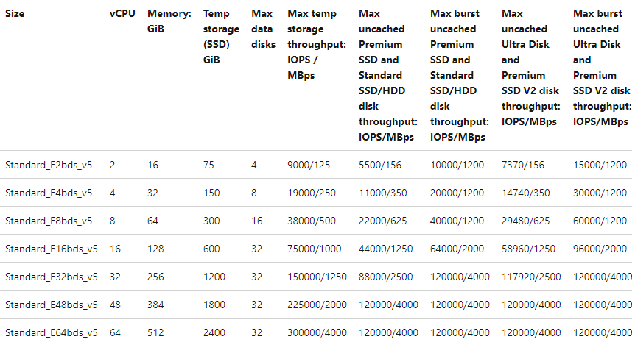
VM I/O Limits
VM network-level provisioning with Premium v2
Notes:
Max uncached disk throughput is the VM-level limit for remote storage.

Slide 27
Understanding I/O Capping
Notes:
DPLESS

Slide 28


Disk-level I/O Capping
SQL Server
Size | Standard_E8ds_v5
Uncached disk throughput: IOPS/MBps | 12800/290
1,500 IOPs
Request
10,000 IOPs
Request
500 IOPs
Request
Standard_E8ds_v5
500 IOPs
Request
1,000 IOPs
Request
4,500 IOPs
Request
500 IOPs
Request
Size | P10
IOPS/MBps | Up to 500/100
4,500 IOPs
Request
Data Disk P10
Data Disk P10
Data Disk P10
Notes:
How does disk performance work?
This is a bit of a recap –remember that Azure virtual machines have IOPS and throughput performance limits based on the virtual machine type and size and all disks will have their own IOPS and throughput limits.
Performance can get capped when the application requests more IOPS (or throughput) than what is allotted for the virtual machines or attached disks.
When capped, applications may experience suboptimal performance through increased latency.
Consider this example… (Disk Throttling..) We have an E8ds_v4. This virtual machine has 8 vCore, 64 GBs of memory. The key piece is that there are 12,800 uncached IOPS for this machine.
In this case we have configured 3 x Premium P10 disks.
There are 3 x P10 data disks that each support up to 500 IOPS and up to 60 MB/second throughput, assume that SQL Server data/log/tempdb files are hosted across them.
Here is the process..
The application makes a request that requires 10,000 IOPS to the virtual machine. This is fine because the Standard_E8ds_v4 virtual machine can handle up to 12,800 IOPS.
The 10,000 IOPS are then broken down into three different requests to the different disks:
1,000 IOPS are requested to the first data disk.
4,500 IOPS are requested to each of the remaining two data disks.
Here’s where we run into a problem.
All attached disks are P10 disks and they can only handle 500 IOPS.
So, the disks respond back with 500 IOPS each. The application's performance is capped by the attached disks, and it can only process 1,500 IOPS to the application.
The application could obtain peak performance at 10,000 IOPS if better-performing disks were used, such as Premium SSD P30 disks.

Slide 29
Disk-level I/O Capping
SQL Server
Size | Standard_E8ds_v5
Uncached disk throughput: IOPS/MBps | 12800/290
10,000 IOPs
Request
10,000 IOPs
Request
1,000 IOPs
Request
Standard_E8ds_v5
4,500 IOPs
Request
1,000 IOPs
Request
4,500 IOPs
Request
4,500 IOPs
Request
Size | P30
IOPS/MBps | Up to 5000/200
4,500 IOPs
Request
Data Disk P30
Data Disk P30
Data Disk P30
Notes:
Okay, now we have upgraded our disks from the Premium SSD P10s to the Premium SSD P30s.
We have improved from 500 IOPS / 60 MBPs, to 5,000 IOPS / 200 MBPs and now the application's performance is not limited.
The application is getting the full 10,000 IOPs it is asking for only because better performing disks were used, such as these Premium SSD P30 disks.
This is good. No throttling is occurring at this disk level.

Slide 30
VM-level I/O Capping
SQL Server
Size | Standard_E8ds_v5
Uncached disk throughput: IOPS/MBps | 12800/290
12,800 IOPs
Request
15,000 IOPs
Request
5,000 IOPs
Request
Standard_E8ds_v5
5,000 IOPs
Request
5,000 IOPs
Request
5,000 IOPs
Request
5,000 IOPs
Request
Size | P30
IOPS/MBps | Up to 5000/200
5,000 IOPs
Request
Data Disk P30
Data Disk P30
Data Disk P30
Notes:
So now… Consider this example… this time at the virtual machine level (VM IO Throttling..)
In this case we are increasing the applications required IOPS. The app is now asking for 15,000 IOPS.
Again… We have a Standard_E8ds_v4. The key piece here is that there are 12,800 uncached IOPS for this machine. We also have the P30 Disks.
There are 3 x P30 data disks that each support up to 5,000 IOPS.
Here is the process..
The application running on the virtual machine makes a request that requires 15,000 IOPS to the VM.
The 15,000 IOPS are then broken down into three different requests to the different disks with 5,000 IOPS are requested to each data disk.
All attached disks are P30 disks and they can handle 5,000 IOPS. So, they respond back with their requested amounts.
Because the E8ds_v4 virtual machine can execute only up to uncached 12,800 IOPS, this limits what is returned to the application.
In this case the virtual machine is capping the IOPS and not the underlying disks.
It may not be by a lot, but the application is not getting all the IOPS it is asking for.

Slide 31
Monitoring I/O Capping
Metrics that help diagnose disk I/O capping
Data Disk IOPS Consumed Percentage
Data Disk Bandwidth Consumed Percentage
Metrics that help diagnose VM I/O capping
VM Cached IOPS Consumed Percentage
VM Cached Bandwidth Consumed Percentage
VM uncached IOPS Consumed Percentage
VM Uncached Bandwidth Consumed Percentage
Notes:
1. With a bullet, storage configuration misses are the most impactful. First, All SSDs are not the same. Standard SSDs are significantly slower than premium. You need premium disks, and you need to make sure you have the block size set to 64KB and the interleave set to 64KB if you are using storage pools. You should also have the NumberofColumns set to the number of disks allocated.
2. Make sure you pick VMs that supports Premium Storage Caching and make sure you enable caching for SQL Server Data Files (read-only) and none for transaction log files. You can avoid issues by making sure you leverage the Azure Marketplace storage configuration wizard.
3. Azure Spot VMs are great if you are looking to save money, but at any point in time when Azure needs the capacity back, the Azure infrastructure will evict Spot VMs.
Spot VMs are great for workloads that can handle interruptions like batch processing, dev/test environments, large compute workloads, and other scenarios where disruptions are acceptable.
If disruptions are not acceptable – do not enable this feature!
4. Burstable disks and virtual machines, such as the B-series VMs, are okay for workloads that do not need the constant, full performance of the CPU like web servers, proof of concepts, and development environments.
The B-series provides you with the ability to purchase a standard VM size that can build up credits when it is using less than its baseline.
When the VM has accumulated credits, the VM can burst above the baseline using up to 100% of the vCPU when your application requires higher CPU performance.
This might work well for smaller web servers and some small to mid-tier business intelligence systems, but this is generally not what you would want for a production SQL Server environment.
4. It is generally recommended to use the latest VM series and the ones we mentioned previously. The previous generation virtual machines are on older hardware and are less likely to support features such as Premium Storage and Premium Storage caching. You may have noticed that the newest M-Series mid tier memory virtual machines were Gen 2 only.
5. ‘Starting with a pre-set configuration’ is an Azure portal option that does too much for you for a production environment. Yes, it is quick and straightforward, but you want to be able to go through the options and validate or make adjustments before you deploy while using the Azure SQL Server IaaS Agent Extension experience.

Slide 32
Monitor I/O capping with Azure Metrics

Slide 33
Understanding Host Caching
Notes:
DPLESS

Slide 34
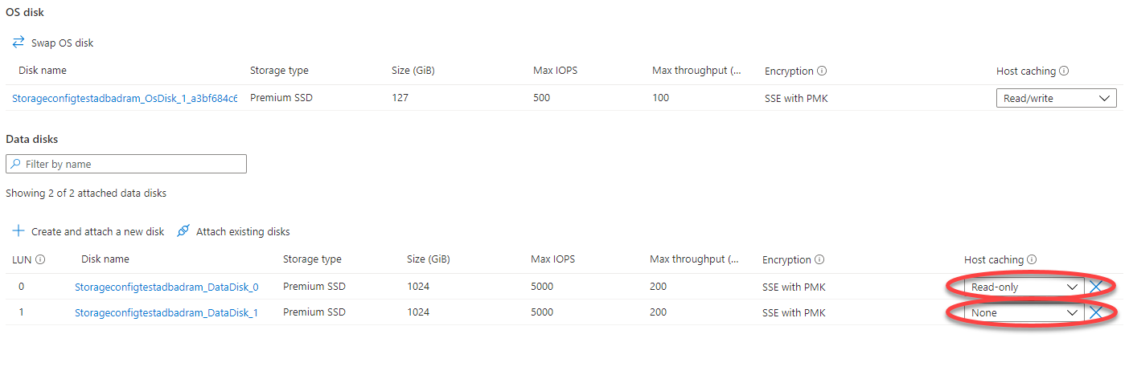
Enabling VM Host Caching
Notes:
Enabling Host VM Caching
You can adjust the host caching to match your workload requirements for each disk. You can set your host caching to be:
None: No caching would be used. This is the default when you add a new data disk.
Read-only: For workloads that do read only operations. This would be your data disks and TempDB if you can’t fit it on the ephemeral D:\ drive.
Read/write: For workloads that do a balance of read and write operations. This is the default for the OS Disk. We do not recommend changing the operating system caching policy.
We do recommend that you use Read-only for data files and any remote tempdb configuration.
We recommend that you use no caching at all for the log file. The log file would not benefit from read caching and you are losing the cache where it could be more useful for other storage needs.
So, you should only be choosing ‘read-only’ caching or ‘none’.

Slide 35


How ReadOnly Caching Works (Reads)
If the data is NOT available in cache…
Read Request
Read Request
Read Response
Read Response
VM Size
Cache
Uncached Disk
Reads are counted toward the VM cached limit and the uncached limit
Notes:
How ReadOnly Caching Works (Reads) –
Let's run through a couple examples of different host cache settings to see how it affects the data flow and performance. In this first example, we'll look at what happens with IO requests when the host caching setting is set to Read-only, but the data is NOT available in cache…
When a read is performed and the desired data is not available on the cache, the read request is sent to the disk.
Then the disk surfaces it to both the cache and the VM.
So, this read is counted toward both the VM's uncached limit and the VM's cached limit.

Slide 36
How ReadOnly Caching Works (Reads)
If the data is available in cache…
Read Request
Read Response
VM Size
Cache
Uncached Disk
Reads are counted toward the VM cached limit, but not the uncached limit
Notes:
How Host Caching Works - If the data is available in cache…
When a read is performed and the desired data is available on the cache, the cache returns the requested data. There is no need to read from the disk. !!!This read is ONLY counted toward the VM's cached limits.

Slide 37
How ReadOnly Caching Works (Writes)
Completing a write operation…
Write Operation
Write Operation
VM Size
Cache
Uncached Disk
Writes are counted toward the VM uncached limit and the cached limit
Notes:
When a write is performed, the write has to be written to both the cache and the disk before it is considered complete.
This write is counted toward the VM's uncached limit and the VM's cached limit.

Slide 38

Benefits of Host Caching
SQL Server
15,000 IOPs
Request
15,000 IOPs
Request
Size | Standard_E8ds_v5
Uncached disk throughput: IOPS/MBps | 12800/290
Temp storage throughput: IOPS/MBps | 38000/500
Standard_E8ds_v5
15,000 IOPs
Request
15,000 IOPs
Request
Size | P30
IOPS/MBps | Up to 5000/200
3,500 IOPs
Request
3,500 IOPs
Request
3,500 IOPs
Request
Host Cache
3,500 IOPs
Request
3,500 IOPs
Request
3,500 IOPs
Request
No VM or Disk Capping!
Data Disk P30 (RO)
Data Disk P30 (RO)
Data Disk P30 (RO)
Notes:
Benefits of Host Caching
We are going back to the previous example, but we are going to fix it with caching.
Again, We are using a E8ds_v5 (12800 IOPS uncached; 38000 IOPS cached ) virtual machine has readonly caching enabled for the data disks.
The application is again requesting 15,000 IOPS.
Assume that about 30% of the 15,000 IOPS are being served from the cache with no need to go to the disks, this means that only about 3,500 IOPS goes to each attached disk.
Because caching is enabled for the underlying storage, we can get the 15,000 IOPS from the cached throughput, and we do not run into the uncached limits of the virtual machine. With caching enabled, even at 15000 IOPS, no performance capping occurs.

Slide 39
Azure SQL VM Best Practices

Slide 40
Ebdsv5 and Premium SSD v2 – Better together! ❤️
Updated best practices guidance coming soon
Opt for Ebdsv5 + Premium SSD v2 unless you know your I/O requirements can be met by other sizes
Set cache=none for high throughput workloads when using Ebdsv5 on Premium v1
Use Premium v2 only with Ebdsv5 if possible
Uncached throughput limits are higher than cached limits so analytical workloads may be hurt by caching
Cached IOPS are higher than uncached IOPS for most sizes so transactional workloads on Pv1 may benefit from caching, but need to test to verify
Premium v2 IOPS limits are higher than Premium v1, so lack of caching does not hurt performance on Eb-series VMs
Evaluate performance on other sizes as it does not support host caching

Slide 41
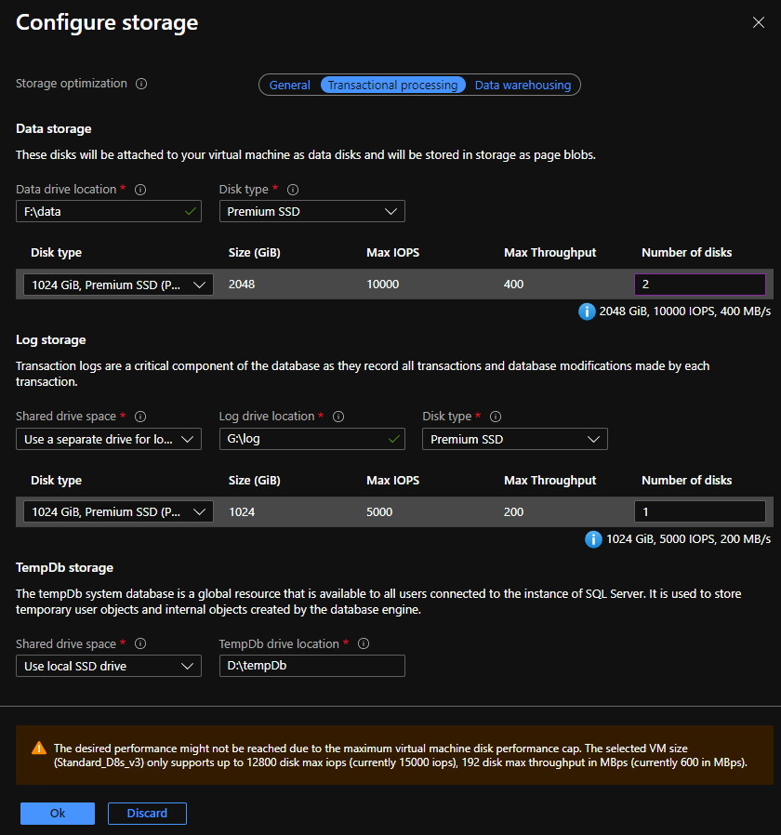
SQL Server on Azure VM Marketplace Images
Storage configuration blade guides customers through proper configuration

Slide 42


Summary: Azure SQL VM Best Practices
Temp Drive
Host Cache
Data
Temp
Log
Choose the right VM
Choose the right disk
Isolate files
Enable host cache
to optimize the storage
mapped to IOPS, BW and latency
to optimize read vs write traffic
for improved IOPS and latency
D:/
Read-heavy
Random-access
Buffered writes
Temp
Low queue depth
Data
Temp
Log
Optimize configuration
Leverage ephemeral disk
Enable Write Accelerator
Leverage Azure Monitor
based on workload behavior
local ephemeral disk for tempdb performance
optimize writes for log files
watch disk and vm counters for capping

Slide 43
References
Checklist: Performance best practices for SQL Server on Azure VMs - https://aka.ms/SQLVMChecklist
VM size: Performance best practices for SQL Server on Azure VMs - https://aka.ms/SQLVMSizing
Storage: Performance best practices for SQL Server on Azure VMs - https://aka.ms/SQLVMStorage
The biggest bang for your buck with SQL Server on Azure VMs - https://aka.ms/AzureSQLVMPricePerf

Slide 44
Questions?

